Slide 1
DAAN 871
E-commerce Trend Analysis

Slide 2
Data Understanding
The dataset contains detailed information about United States e-commerce records in 2020.
The dataset provided represents an e-commerce transaction log with various columns containing information about each order.
It includes details such as the order date, order ID, shipping mode, customer ID, market segment, and geographic information like the country, city, state, postal code, and region.
Product-related information consists of the product ID, category, sub-category, product name, sales, quantity, discounts applied, and profit margins.
The dataset's columns offer a comprehensive view of the e-commerce business, making it suitable for various analyses, such as sales trends, customer segmentation, and profitability assessments.
The data was taken from Kaggle, a data science competition platform and online community of data scientists and machine learning practitioners.
Number of Attributes: 19
Number of Instances: 3313
90%
70%
40%
2020
Sales Analysis

Slide 3
Research Goals
Query 1
Query 2
15%
What effects do shipping methods have on sales across different areas?
In 2020, which product categories and subcategories yielded the highest and lowest profits?
15%
25%
Query 3
Query 4
35%
Does giving larger discounts have a detrimental impact on profitability,
Can specific consumer segments be identified based on their purchasing patterns, and how do they vary in terms of average buy value and discount usage?

Slide 4
1) Which product categories and subcategories yielded the highest and lowest profits?
Chart Used : Horizontal bar chart
A horizontal bar chart is used for comparing the highest and lowest profits of product categories and subcategories in 2020. Its clear orientation, efficient space utilization, and sorting capabilities make it easy for users to identify top performers. The clean design and interactivity options further enhance the visualization experience.
The visualization employs a horizontal bar graph, offering an initial overview of profits categorized by product categories. Users can seamlessly drill down by selecting specific categories, leading to subcategories and individual products.
Toggling between these levels enables users to explore profits at different granularities. The color-coded scheme, with red indicating losses and blue for profits, enhances clarity, and specific information is highlighted numerically

Slide 5
Design Principles
Data-Ink Ratio
Hierarchy and Drill-Down
he design maximizes the data-ink ratio, following Edward Tufte's principle, by conveying detailed profit information without unnecessary embellishments
The design incorporates a hierarchy from categories to subcategories and individual products, aligning with Few's principle of clear data presentation
Color Coding for Clarity
Emphasis on Specific Information
Color Coding for Clarity: The use of color-coded profits (red for losses and blue for profits) adheres to both Tufte and Few's principles
Utilized color and numerical indicators to highlight and emphasize key profit data points for user understanding following Few's principle
Clean and Clear Design
The overall design is clean and uncluttered, avoiding unnecessary elements. This adheres to Tufte's principle of simplicity and clarity, ensuring that the visualization effectively communicates profit information without visual distractions

Slide 6
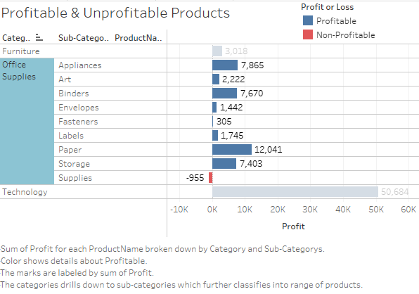

Slide 7
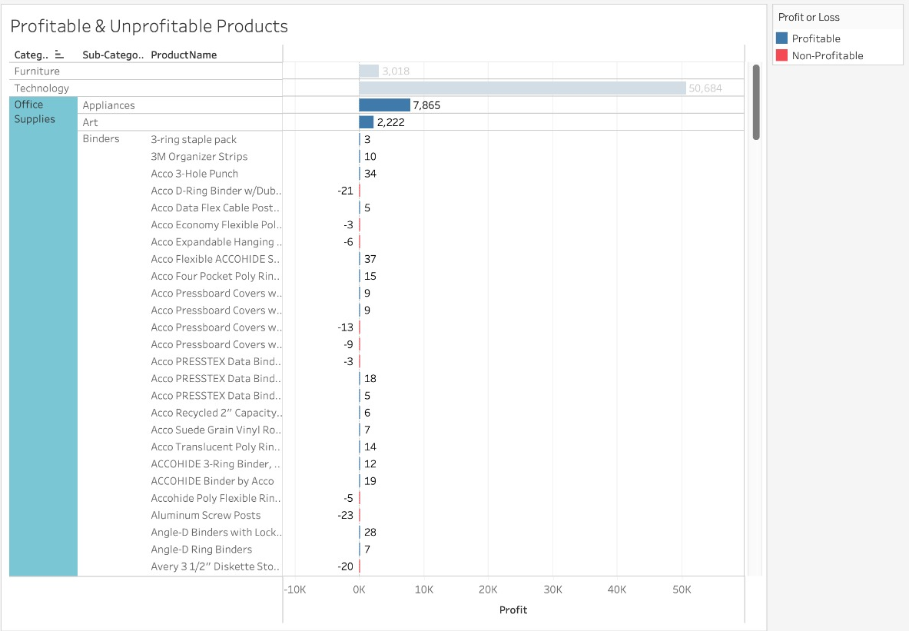

Slide 8
2) What effects do shipping methods have on sales across different areas?
Chart Used : Spatial charts
A spatial chart in Tableau is ideal for analyzing the impact of shipping methods on sales across diverse areas. It provides a visual representation that allows for quick identification of regional variations and trends, enhancing the understanding of how different shipping methods affect sales geographically. The interactive features further facilitate detailed exploration for nuanced insights.
The visualization offers the flexibility to examine sales across various regions based on ship modes. Users can drill down to select specific ship modes, and the chart represents state-wise sales through color hues, providing a visual indication. Detailed information is available via tooltips when hovering over a particular state.
Additionally, city-wise sales and shipping methods are highlighted using color-gradient bubbles for users interested in a more granular analysis at the city level.

Slide 9
Design Principles
Clarity and Simplicity
Interactivity
It follows Tufte's principle by presenting the data in a straightforward manner, allowing users to quickly interpret sales information across regions and shipping methods
The drill-down functionality and tooltips provide interactive features, adhering to Few's emphasis on user interactivity to facilitate exploration and analysis
Maximizing Information
Color Coding for Meaning
The visualization maximizes information in a compact space, incorporating multiple layers of data without clutter, reflecting both Tufte's and Few's principles of effective data visualization
Use of color hues to represent state-wise sales & color gradient bubbles for city-level sales follows Few's principle of using color to convey meaningful information

Slide 10
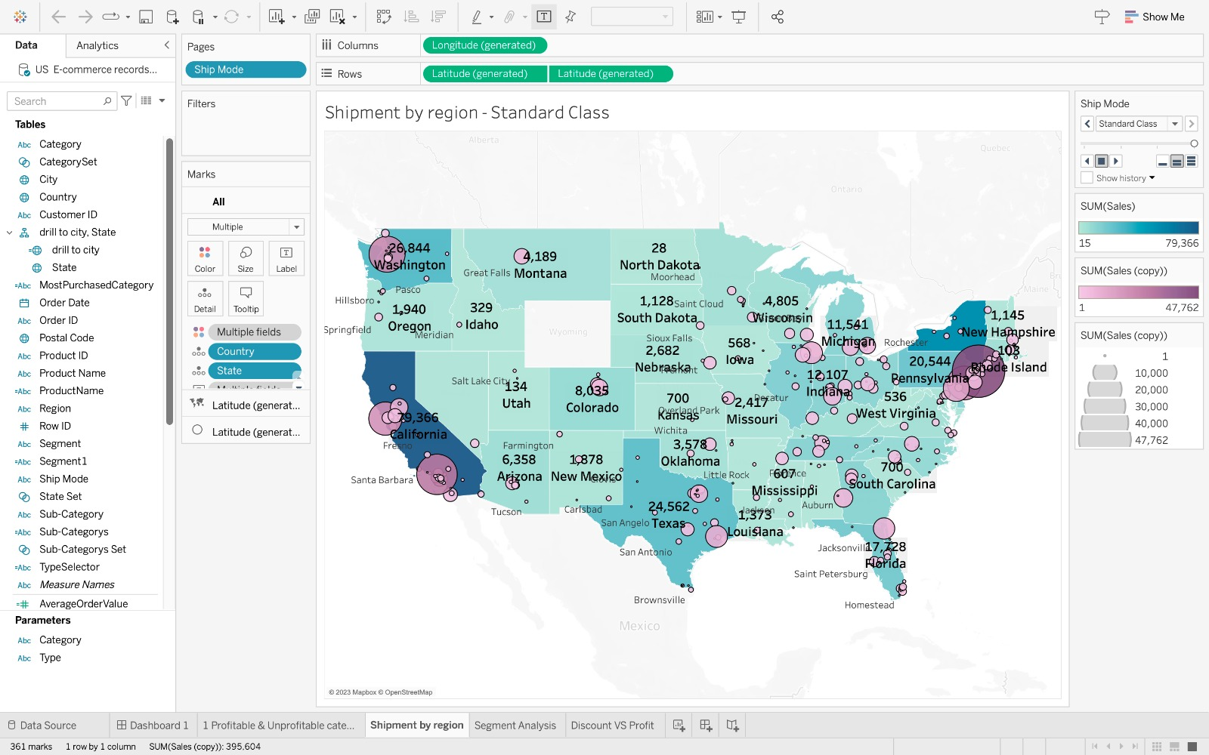

Slide 11
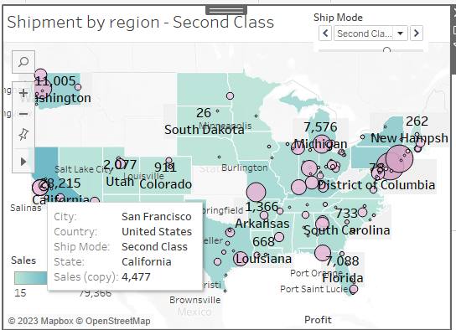

Slide 12
3) Can specific consumer segments be identified based on their purchasing patterns, & how do they vary in terms of average buy value and discount usage?
Chart Used : Segmentation chart
Segmentation chart visually represents variations in average purchase value and discount usage, offering a clear and concise comparison of different consumer behaviors within distinct segments and regions. This visualization facilitates insights into the diverse characteristics of consumer sector based on segments or region.
The graph features a drill-down option allowing users to choose between regions or segments. If the segment is selected, the graph dynamically generates plots for distinct segments based on the available data.
For each segment, five plots are presented, depicting sales, profit, purchase frequency, and average order value against time. The same drill-down functionality applies to regions, offering a comprehensive exploration of key metrics for different segments and regions over time

Slide 13
Design Principles
Clear information
Memory retention
The drill-down functionality allows users to focus on specific regions or segments, ensuring that the displayed information is relevant to the user's selection.
The combination of multiple plots for each segment and region aids in memory retention, allowing users to compare information within their eye span
Maximizing Information
Visually salient
Overall, the visualization maximizes information by providing a comprehensive view of sales-related metrics over time, incorporating multiple layers of data in a concise manner
The drill-down plots prioritize key metrics (sales, profit, purchase frequency, and average order value), making crucial information visually prominent.

Slide 14
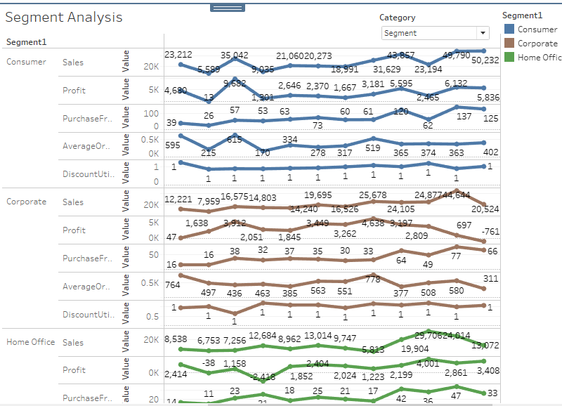

Slide 15
4) Does giving larger discounts have a detrimental impact on profitability
Chart Used : Tree map
Tree map represents hierarchical product categories and subcategories. The size and color-coding of rectangles within the tree map provide a clear indication of how larger discounts may affect profitability across different levels of the product hierarchy. This hierarchical visualization facilitates a nuanced analysis of the relationship between discounting strategies and overall profitability.
Users can select from categories, subcategories, regions, or products, and based on their choice, a tree map is generated. The size within the tree map is determined by the discount, while the color hue is based on the profit. Additionally, the category, subcategory, or selected item is labeled along with the correlation value between discount and profit, providing a comprehensive visual representation of the relationship between these two variables.

Slide 16
Design Principles
Accuracy
Efficiency
The visualization avoids unnecessary visual differences and ensures that differences in visual properties, such as color and size, accurately correspond to actual differences in the data, aligning with Few's principles.
The visualization aligns with Tufte's principles of graphical excellence by providing a clear, efficient, and multivariate representation of the correlation between discount levels and profitability.
Memory Augmentation
Relevance
The inclusion of correlation values and clear labeling enhances memory retention by presenting relevant information within the user's eye span, aligning with Few's principle of augmenting short-term memory
Visualization adheres to the principle of displaying only relevant information, as users can choose specific categories or items, ensuring that the displayed data is tailored to their message or inquiry

Slide 17
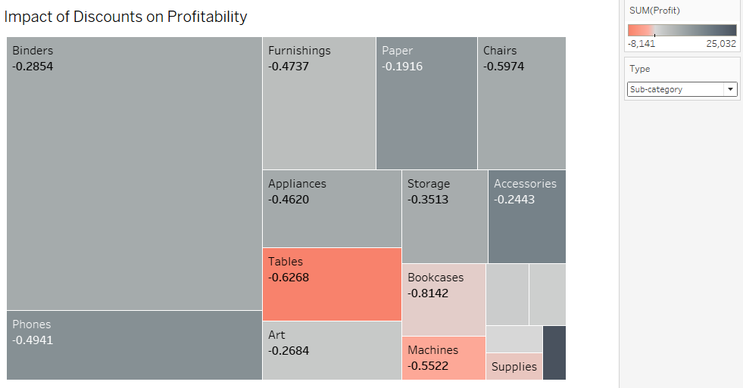

Slide 18
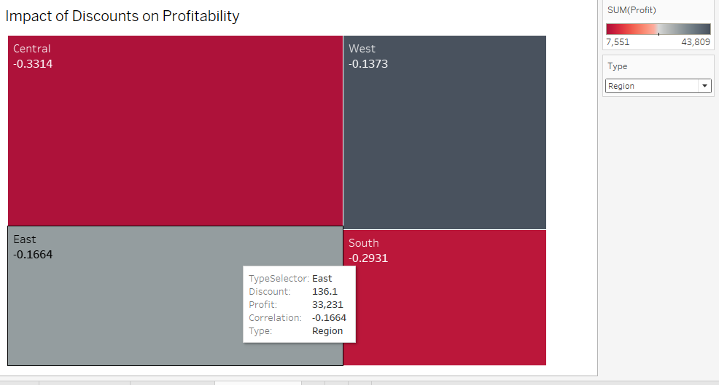

Slide 19
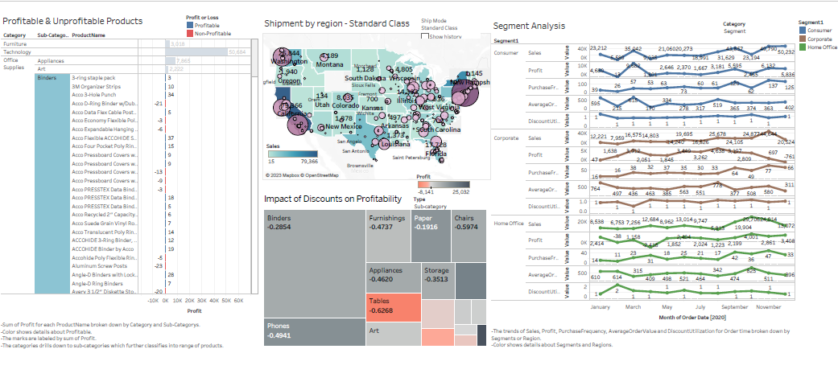
Dashboard

Slide 20
INFERENCES
Question 1:
Which product categories and subcategories yielded the highest and lowest profits?
75%
The visualization reveals that within the categories, "Technology" stands out with the highest profit at 50,684 units, while "Furniture" records the lowest profit at 2018 units. Among the sub-categories, "Tables" emerges as a loss-making item with a deficit of -8,141 units, whereas "Copiers" proves to be the most profitable item, yielding a profit of 25,032 units.
65%
Question 2:
What effects do shipping methods have on sales across different areas?
The standard class shipping method is widely utilized across the country, resulting in higher sales compared to other methods. While California leads in overall sales with 79,366, New York surpasses other states with the highest sales in cities, reaching 46,762. Interestingly, the "Same Day" shipping option is the least favored nationwide.

Slide 21
INFERENCES
Question 3:
Can specific consumer segments be identified based on their purchasing patterns, & how do they vary in terms of average buy value and discount usage?
500
In the customer segment analysis, both consumers and corporate buyers tend to make more purchases in November, evident from spikes in sales, profit, purchase frequency, and average order value during that month. Conversely, for home office buyers, the peak in sales, profit, and purchase frequency occurs in October.
400
300
200
Question 4:
Does giving larger discounts have a detrimental impact on profitability?
100
Certainly, offering discounts is observed to have a negative impact on profit, indicated by the negative correlation values in the visualization across all types. However, it's noteworthy that the magnitude (amount) of the discount does not exhibit a direct correlation with the profit margin; they appear to be independent in terms of proportions.
Item 1
Item 2
Item 3
Item 4

Slide 22
THANK YOU!!
71+
70
60
50
40
30
20
100%
75%
50%
25%
0%
25%
50%
75%
100%

